Slide 1

Apache Kafka Basics
Apache Kafka is an open-source distributed event streaming platform used by thousands of companies for high-performance data pipelines, streaming analytics, data integration, and mission-critical applications.

Slide 2
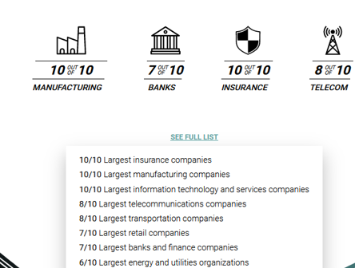
Apache Kafka Scale of Presence

Slide 3
Features: Core Capabilities
High Throughput: Deliver messages at network limited throughput using a cluster of machines with latencies as low as 2ms.
Scalable: Scale production clusters up to a thousand brokers, trillions of messages per day, petabytes of data, hundreds of thousands of partitions. Elastically expand and contract storage and processing.
Permanent storage: Store streams of data safely in a distributed, durable, fault-tolerant cluster.
High availability: Stretch clusters efficiently over availability zones or connect separate clusters across geographic regions.

Slide 4
Features: Ecosystem
Built-in Stream Processing: Process streams of events with joins, aggregations, filters, transformations, and more, using event-time and exactly-once processing.
Connect To Almost Anything: Kafka’s out-of-the-box Connect interface integrates with hundreds of event sources and event sinks including Postgres, JMS, Elasticsearch, AWS S3, and more.
Client Libraries: Read, write, and process streams of events in a vast array of programming languages.
Large Ecosystem Open Source Tools: Leverage a vast array of community-driven tooling.

Slide 5
Features: Trust & Ease Of Use
Mission Critical: Support mission-critical use cases with guaranteed ordering, zero message loss, and efficient exactly-once processing.
Trusted By Many: Thousands of organizations use Kafka, from internet giants to car manufacturers to stock exchanges with more than 5 million unique lifetime downloads. More than 80% of all Fortune 100 companies trust, and use Kafka
Vast User Community: Kafka is one of the five most active projects of the Apache Software Foundation, with hundreds of meetups around the world.
Rich Online Resources: Rich documentation, online training, guided tutorials, videos, sample projects, Stack Overflow, etc.

Slide 6
Event Streaming
Event streaming: It is Technological foundation for the 'always-on' world where businesses are increasingly software-defined and automated, and where the user of software is more software.
It is the practice of capturing data in real-time from event sources like databases, sensors, mobile devices, cloud services, and software applications in the form of streams of events
Storing these event streams durably for later retrieval; manipulating, processing, and reacting to the event streams in real-time as well as retrospectively
Routing the event streams to different destination technologies as needed

Slide 7
Event Streaming – Use Cases
To process payments and financial transactions in real-time, such as in stock exchanges, banks, and insurances.
To track and monitor cars, trucks, fleets, and shipments in real-time, such as in logistics and the automotive industry.
To continuously capture and analyze sensor data from IoT devices or other equipment, such as in factories and wind parks.

Slide 8
Event Streaming – Use Cases
To collect and immediately react to customer interactions and orders, such as in retail, the hotel and travel industry, and mobile applications.
To monitor patients in hospital care and predict changes in condition to ensure timely treatment in emergencies.
To connect, store, and make available data produced by different divisions of a company.
To serve as the foundation for data platforms, event-driven architectures, and Microservices.

Slide 9
3 Key Capabilities
Kafka combines three key capabilities so you can implement your use cases for event streaming end-to-end with a single battle-tested solution:
To publish (write) and subscribe to (read) streams of events, including continuous import/export of your data from other systems.
To store streams of events durably and reliably for as long as you want.
To process streams of events as they occur or retrospectively.

Slide 10
How does Kafka work
Kafka is a distributed system consisting of servers and clients that communicate via a high-performance TCP protocol.
Servers: Kafka is run as a cluster of one or more servers that can span multiple datacenters or cloud regions.
Some of these servers form the storage layer, called the brokers.
Other servers run Kafka Connect to continuously import and export data as event streams to integrate Kafka with your existing systems such as relational databases as well as other Kafka clusters.

Slide 11
How does Kafka work
Clients: They allow you to write distributed applications and Microservices that read, write, and process streams of events in parallel, at scale, and in a fault-tolerant manner even in the case of network problems or machine failures.
Clients are available for Java and Scala including the higher-level Kafka Streams library, for Go, Python, C/C++, and many other programming languages as well as REST APIs.

Slide 12
Events
An event records the fact that "something happened" in the world or in your business.
It is also called record or message in the documentation.
When you read or write data to Kafka, you do this in the form of events.
Conceptually, an event has a key, value, timestamp, and optional metadata headers.
Here's an example event:
Event key: "Alice"
Event value: "Made a payment of $200 to Bob"
Event timestamp: "Jun. 25, 2020 at 2:06 p.m."

Slide 13
Topics
Kafka provides various guarantees such as the ability to process events exactly-once.
Events are organized and durably stored in topics.
Very simplified, a topic is similar to a folder in a filesystem, and the events are the files in that folder.
Topics in Kafka are always multi-producer and multi-subscriber: a topic can have zero, one, or many producers that write events to it, as well as zero, one, or many consumers that subscribe to these events.

Slide 14
Topics
Events in a topic can be read as often as needed—unlike traditional messaging systems, events are not deleted after consumption.
Instead, you define for how long Kafka should retain your events through a per-topic configuration setting, after which old events will be discarded.
Kafka's performance is effectively constant with respect to data size, so storing data for a long time is perfectly fine.

Slide 15
Topics - Scaling
Kafka scales writes and reads by sharding topic logs into partitions
Topics logs can be split into multiple partitions which can be stored on multiple different servers/brokers
Multiple producers can write to different partitions of the same topic.
Multiple consumers from multiple consumer groups can read from different partitions efficiently.
Topic partitions are a unit of parallelism
Kafka can replicate partitions across a configurable number of kafka servers which is used for fault tolerance.

Slide 16
Topic Partitioning
A topic is spread over a number of "buckets" located on different Kafka brokers.
This distributed placement of data is very important for scalability because it allows client applications to both read and write the data from/to many brokers at the same time.
When a new event is published to a topic, it is actually appended to one of the topic's partitions.
Events with the same event key (e.g., a customer or vehicle ID) are written to the same partition, and Kafka guarantees that any consumer of a given topic-partition will always read that partition's events in exactly the same order as they were written.

Slide 17
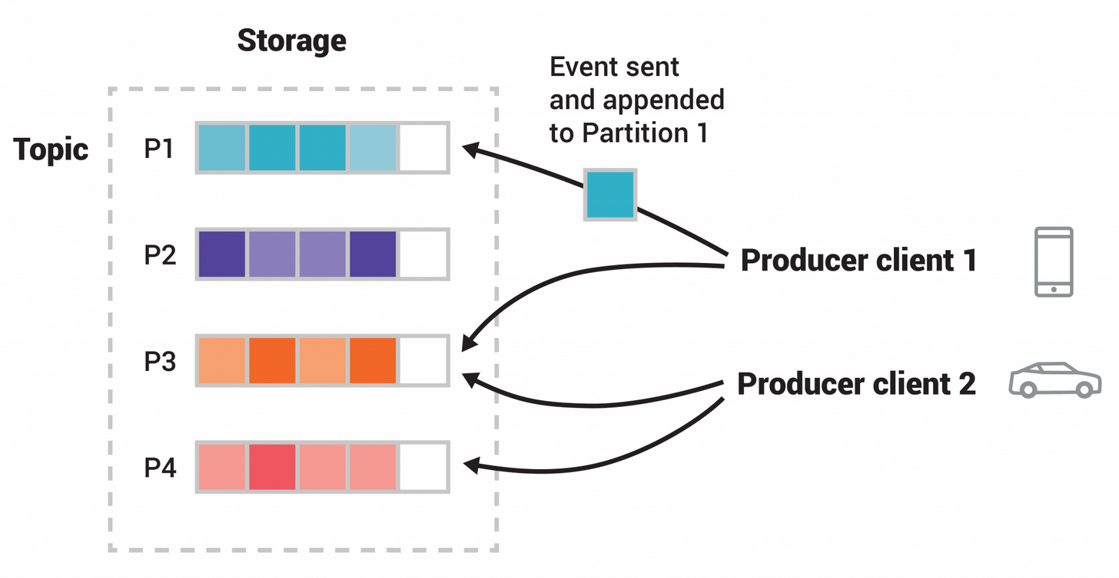
Topic Partitioning

Slide 18
Topic Partitioning
This example topic has four partitions P1–P4.
Two different producer clients are publishing, independently from each other, new events to the topic by writing events over the network to the topic's partitions.
Events with the same key (denoted by their color in the figure) are written to the same partition.
Note that both producers can write to the same partition if appropriate.

Slide 19
Topic Replication
To make the system fault-tolerant and highly-available, every topic can be replicated, even across geo-regions or datacenters
So there are always multiple brokers that have a copy of the data just in case things go wrong, you want to do maintenance on the brokers, and so on.
Topics are split into a pre-defined number of partitions, P, and each partition is replicated with some replication factor, N
A common production setting is a replication factor of 3, i.e., there will always be three copies of your data.

Slide 20
Directing the Messages to Partitions
All systems of this nature have the question of how a particular piece of data is assigned to a particular partition.
Kafka clients directly control this assignment, the brokers themselves enforce no particular semantics of which messages should be published to a particular partition.
To publish messages the client directly addresses messages to a particular partition, and when fetching messages, fetches from a particular partition
If two clients want to use the same partitioning scheme they must use the same method to compute the mapping of key to partition.

Slide 21
Broker Network and Clustering
How can the client find out which topics exist, what partitions they have, and which brokers currently host those partitions so that it can direct its requests to the right hosts?
These requests to publish or fetch data must be sent to the broker that is currently acting as the leader for a given partition.
This condition is enforced by the broker, so a request for a particular partition to the wrong broker will result in an the NotLeaderForPartition error code.

Slide 22
Broker Network and Clustering
This information is dynamic, so you can't just configure each client with some static mapping file.
Instead all Kafka brokers can answer a metadata request that describes the current state of the cluster: what topics there are, which partitions those topics have, which broker is the leader for those partitions, and the host and port information for these brokers.
In other words, the client needs to somehow find one broker and that broker will tell the client about all the other brokers that exist and what partitions they host.

Slide 23
Broker Network and Clustering
This first broker may itself go down so the best practice for a client implementation is to take a list of two or three URLs to bootstrap from.
The user can then choose to use a load balancer or just statically configure two or three of their Kafka hosts in the clients.
The client does not need to keep polling to see if the cluster has changed; it can fetch metadata once when it is instantiated cache for metadata until it receives an error indicating that the metadata is out of date.

Slide 24
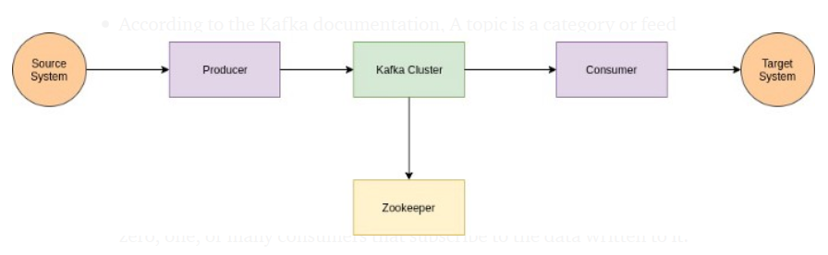
Kafka Conceptual Diagram

Slide 25
Zookeeper
Zookeeper is a top-level software developed by Apache that acts as a centralized service and is used to maintain naming and configuration data and to provide flexible and robust synchronization within distributed systems.
Zookeeper keeps track of status of the Kafka cluster nodes and it also keeps track of Kafka topics, partitions etc.
Zookeeper it self is allowing multiple clients to perform simultaneous reads and writes and acts as a shared configuration service within the system

Slide 26
Zookeeper Duties
Controller election: The controller is one of the most important broking entity in a Kafka ecosystem, and it also has the responsibility to maintain the leader-follower relationship across all the partitions.
So, whenever a node shuts down, a new controller can be elected and it can also be made sure that at any given time, there is only one controller and all the follower nodes have agreed on that.
Configuration of Topics: The configuration regarding all the topics including the list of existing topics, the number of partitions for each topic, the location of all the replicas, list of configuration overrides for all topics and which node is the preferred leader, etc.

Slide 27
Zookeeper Duties
Access control lists: ACLs for all the topics are also maintained within Zookeeper.
Membership of the cluster: Zookeeper also maintains a list of all the brokers that are functioning at any given moment and are a part of the cluster.
Zookeeper sends changes of the topology to kafka, so each node in the cluster knows when a new broker joins, a broker dies, a topic was removed or a topic was added, etc.
Zookeeper provides an in-sync view of kafka cluster configuration.

Slide 28
Kafka Connect
Kafka Connect is a tool for scalably and reliably streaming data between Apache Kafka and other systems.
It makes it simple to quickly define connectors that move large collections of data into and out of Kafka.
Kafka Connect can ingest entire databases or collect metrics from all your application servers into Kafka topics, making the data available for stream processing with low latency.
An export job can deliver data from Kafka topics into secondary storage and query systems or into batch systems for offline analysis.

Slide 29
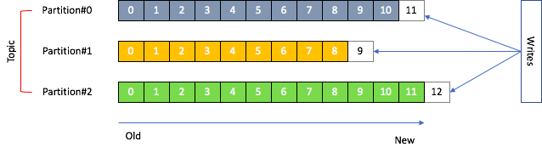
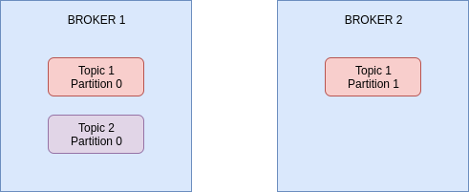
Kafka Conceptual Diagram

Slide 30
Concept of Leader for a Partition
Each partition will have a Leader and multiple ISR(in-sync replicas).
ISR is the number of redundant copies apart the one that exist on the leader.
Only leader can receive and serve data for that partition.
If leader goes down, then one of ISR becomes the leader.
When the leader comes back, the temporary leader goes back to ISR.

Slide 31
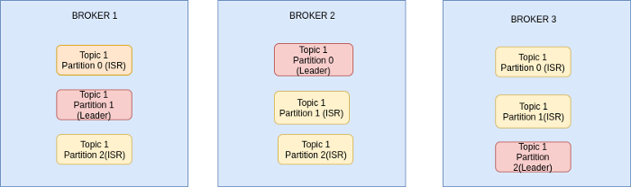
Concept of Leader for a Partition
Suppose We have 3 brokers, a Topic with 3 partition and replication factor of 3, all 3 partition would be on all 3 brokers.
But only one broker can be a Leader for given partition.

Slide 32
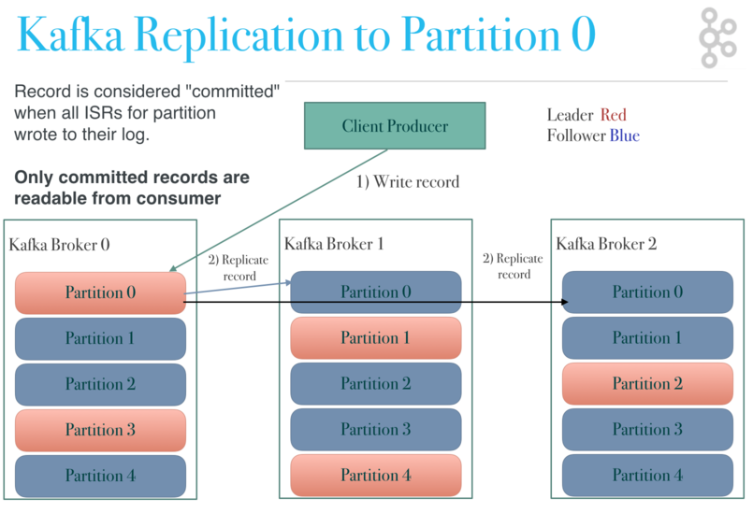

Slide 33
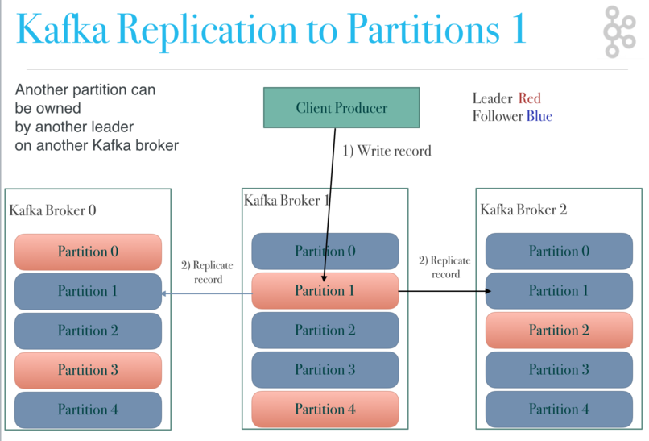

Slide 34
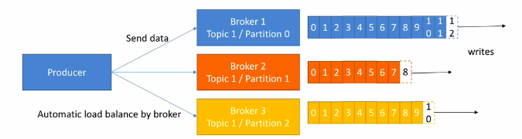
Kafka Producers
Producers knows which broker and partition to write to.
If you send the messages without specifying key, the messages would be sent to brokers in round robin.
This will ensure equal load on every broker i.e load balancing.
But if you send messages with key, all the messages for that key will be stored in the same partition.

Slide 35
Kafka Producers
When the data is send to brokers, producer can be configured to receive confirmation of messages.
ack=0. No acknowledgment, this has possible data loss.
ack=1. Only leader will send acknowledgment, it would have limited data loss.
ack=all. All the ISR and leader will send acknowledgment, No data loss,slower speed of processing.

Slide 36
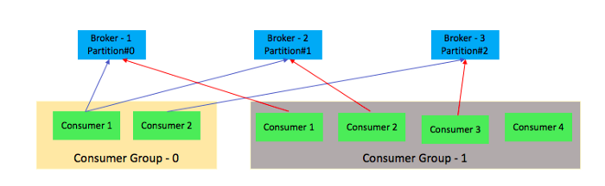
Kafka Consumer Groups
Data is read in order within each partition.
Consumer groups have multiple consumers, within a consumer group, a consumer will read data from set of partitions. For any given partition, only one consumer will read from it.
If you have more consumers than partitions within a consumer group, some consumers would be inactive(in below diagram, Consumer 4 is inactive).

Slide 37
Kafka Consumer Groups
One consumer group might be responsible for delivering records to high-speed, in-memory microservices while another consumer group is streaming those same records to Hadoop.
A consumer group has a unique id.
Each consumer group is a subscriber to one or more kafka topics.
Each consumer group maintains its offset per topic partition.
A record gets delivered to only one consumer in a consumer group.

Slide 38
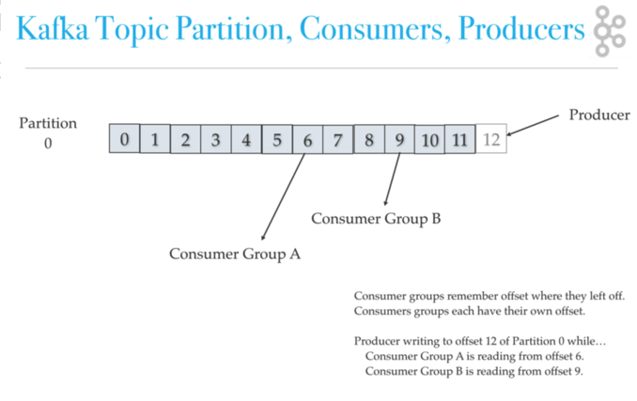
Kafka Consumer Groups

Slide 39
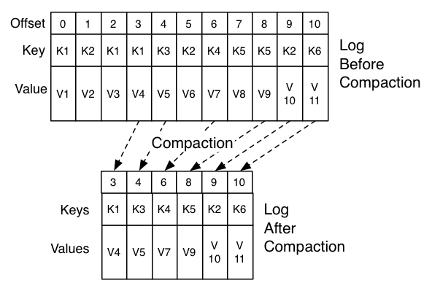
Log Compaction
kafka stores offset data in a topic called "__consumer_offset" .
These topics use log compaction, which means they only save the most recent value per key.

Slide 40
kafka consumer failover
Consumers notify the kafka broker when they have successfully processed a record, which advances the offset.
If a consumer fails before sending commit offset to kafka broker, then a different consumer can continue from the last committed offset.
If a consumer fails after processing the record but before sending the commit to the broker, then some kafka records could be reprocessed.
In this scenario, kafka implements the at least once behavior, and you should make sure the messages (record deliveries ) are idempotent.

Slide 41
kafka consumer failover
At most once: Offset are committed as soon as message is received.
If processing goes wrong then message will be lost. (Not preferred way).
At least once: Offset are committed after message is processed.
If processing goes wrong then message will be read again. (Preferred way).
Only once: This is used only for Kafka to Kafka workflows.

Slide 42
Kafka Failover Cases
If a consumer in a consumer group dies, the partitions assigned to that consumer is divided up amongst the remaining consumers in that group.
An isr is an in-sync replica, if a leader fails, an isr is picked to be a new leader.
If a broker dies, then kafka divides up leadership of its topic partitions to the remaining brokers in the cluster.

Slide 43
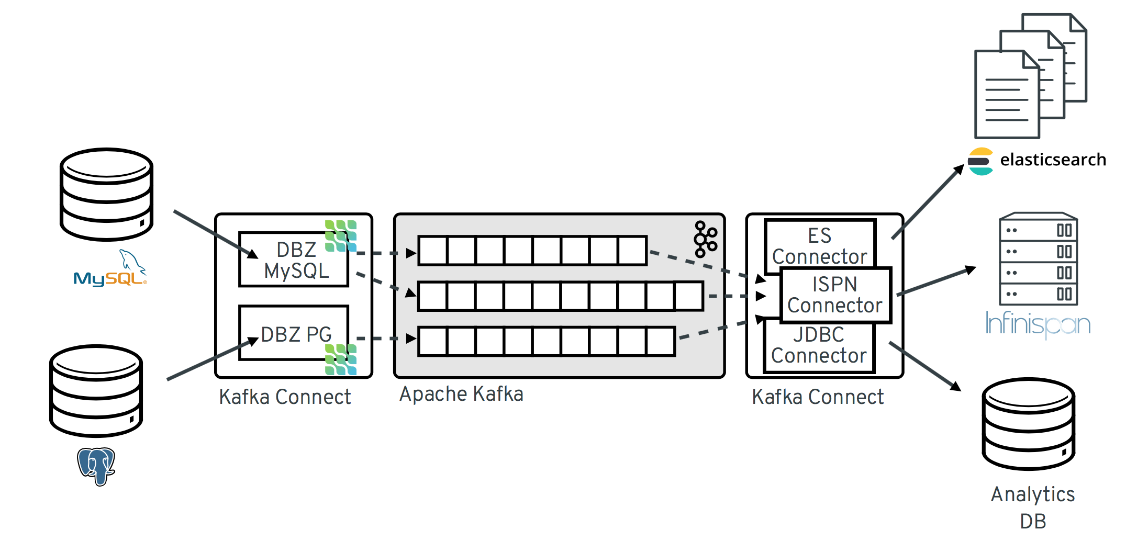
Kafka Use Cases
Messaging: Kafka works well as a replacement for a more traditional message broker.
In comparison to most messaging systems Kafka has better throughput, built-in partitioning, replication, and fault-tolerance which makes it a good solution for large scale message processing applications.
In this domain Kafka is comparable to traditional messaging systems such as ActiveMQ or RabbitMQ.

Slide 44
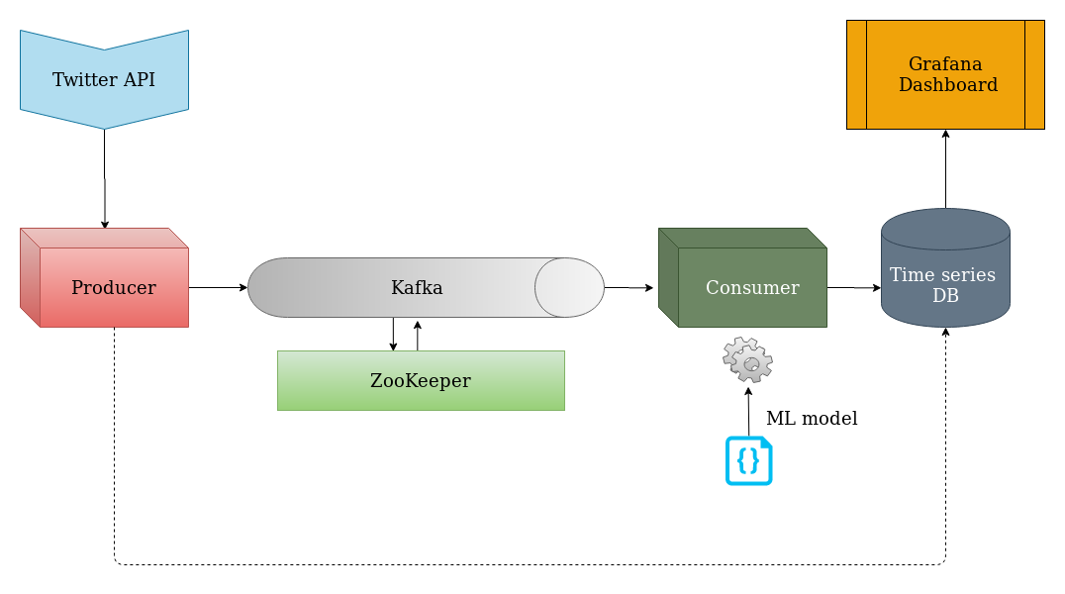
Real Time Streaming

Slide 45
Real Time Streaming
Producer: It gets the tweets from the Twitter API and sends/queues — the id and text of the tweets into a Kafka topic
Consumer: It simply loads the tweets one by one from Kafka, performs a pre-processing and feature extraction step with supervised learning model using Naive Bayes Classifier, then infers the polarity of each tweet — positive or negative.
This polarity is stored in the time-series database, along with the tweet’s ID, for visualization purposes
Time-series Database: A time-series database like Influx is a data store that uses timestamps to index records. This means that for each new record, the DB engine associates a timestamp, which is the amount of time in nano-second

Slide 46
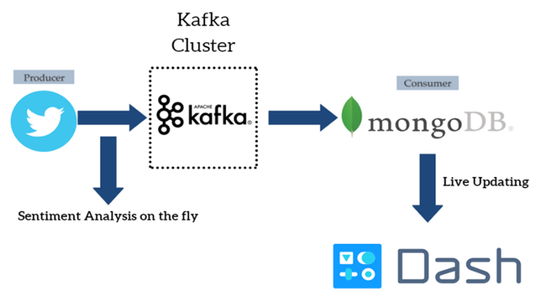
Real Time Streaming

Slide 47
Kafka Use Cases
Stream Processing: Many users of Kafka process data in processing pipelines consisting of multiple stages, where raw input data is consumed from Kafka topics and then aggregated, enriched, or otherwise transformed into new topics for further consumption or follow-up processing.
For example, a processing pipeline for recommending news articles might crawl article content from RSS feeds and publish it to an "articles" topic
Further processing might normalize or deduplicate this content and publish the cleansed article content to a new topic
A final processing stage might attempt to recommend this content to users

Slide 48
Kafka Use Cases
Website Activity Tracking: To rebuild a user activity tracking pipeline as a set of real-time publish-subscribe feeds. (Kafka Original Use Case)
Site activity (page views, searches, or other actions users may take) is published to central topics with one topic per activity type.
These feeds are available for subscription for a range of use cases including real-time processing, real-time monitoring, and loading into Hadoop or offline data warehousing systems for offline processing and reporting.

Slide 49
Kafka Use Cases
Log Aggregation: Many people use Kafka as a replacement for a log aggregation solution.
Log aggregation typically collects physical log files off servers and puts them in a central place (a file server or HDFS perhaps) for processing.
Kafka abstracts away the details of files and gives a cleaner abstraction of log or event data as a stream of messages.
This allows for lower-latency processing and easier support for multiple data sources and distributed data consumption.
In comparison to log-centric systems, Kafka offers equally good performance, stronger durability guarantees due to replication, and much lower end-to-end latency

Slide 50
Kafka Use Cases
Metrics: Kafka is often used for operational monitoring which involves aggregating statistics from distributed applications to produce centralized feeds of operational data.
Event Sourcing: Event sourcing is a style of application design where state changes are logged as a time-ordered sequence of records.
Kafka's support for very large stored log data makes it an excellent backend for an application built in this style.
Commit Log: Kafka can serve as a kind of external commit-log for a distributed system, this log helps replicate data between nodes and acts as a re-syncing mechanism for failed nodes to restore their data.

Slide 51
Commit Logs are source of truth
It provides a single place for all parts of the system to find changes
It imposes an order on those changes
E-commerce application made up of five distinct services: catalog, payments, orders, customers, and shipping.
The order system writes the customer’s order to the log.
The catalog system reads the order from the log and checks that there is sufficient stock to fulfill it. It finds there is and so temporarily reduces the stock count accordingly and writes a new record to the log indicating that the order can be fulfilled.
The payment system reads the record showing that the order can be fulfilled and attempts to take payment from the customer’s card. The payment is successful and the payment system writes back to the log that the order can progress

Slide 52
Commit Logs are source of truth
A
B
C
The shipping system reads the log and prepares the order for dispatch.
The customer system reads the same entry and updates the customer’s record with details of their new order.
A dispatcher in the warehouse marks the package as sent in the shipping system. The shipping system writes to the log that the package has shipped.
The customer system sees that status change from the shipping system and updates the customer’s tracking information accordingly.
The catalog confirms the earlier temporary reduction in stock level.
There’s no danger that one service might accidentally pre-empt or overrule another because everything happens in order.
Another benefit is that, so long as the log is available, the system can theoretically continue even when some components are offline.

Slide 53
LinkedIn Kafka Use Case
Apache Kafka has its origin at LinkedIn.
It was actually created to solve their challenges with systems related to monitoring, tracing and user activity tracking.
The streaming ecosystem built around Apache Kafka is a key part of technology stack at LinkedIn.
Apache Kafka is used at LinkedIn for activity tracking, message exchanges, operational metrics and powering many other products

Slide 54
LinkedIn Kafka Use Case
While many other companies and projects leverage Kafka, few—if any—do so at LinkedIn’s scale.
Today LinkedIn handles 7 trillion messages per day, divided into 100,000 topics, 7M partitions, stored over 4000 brokers in 100 Kafka clusters
LinkedIn has their own patches and releases of Kafka, so that they can get some features earlier, before they get accepted to the official packages.

Slide 55
Netflix Kafka Use Case
Operating 36 Kafka clusters consisting of 4,000+ broker instances with More than 700 billion messages are ingested on an average day. (2016)
Here are some statistics about the data pipeline:
Trillions of events and petabytes worth of data per day to support day to day business needs
~8 million events and ~24 GB per second during peak hours (not recent)
There are several hundred event streams flowing through the pipeline,
Video viewing activities
UI activities
Error logs
Performance events
Troubleshooting & diagnostic events

Slide 56
Netflix Kafka Use Case
Example: Netflix uses Kafka to apply recommendation in real-time while you are watching TV shows
Favor multiple small Kafka clusters as opposed to one giant cluster. This reduces the operational complexity for each cluster. Their largest cluster has less than 200 brokers.
Limit the number of partitions in each cluster. Each cluster has less than 10,000 partitions. This improves the availability and reduces the latency for requests/responses that are bound to the number of partitions.
Strive for even distribution of replicas for each topic. Even workload is easier for capacity planning and detection of outliers.
Use dedicated ZooKeeper cluster for each Kafka cluster to reduce the impact of ZooKeeper issues.

Slide 57
Uber Kafka Use Case
Apache Kafka is a core part (Data Hub) of Uber’s overall infrastructure stack and powers various online & near realtime use-cases.
Example: Uber uses Kafka to gather taxi, user and trip data in real-time to compute and forecast demand and compute surge pricing in real-time
They handle trillion+ (info from 2017!) messages per day over tens of thousand of topics generating PBs of data per day
Many processes are modeled using Kafka Streams, even so important ones like customer and driver matching, together with ETAs calculations or the auditing.
Data is divided into regional Kafka Clusters

Slide 58
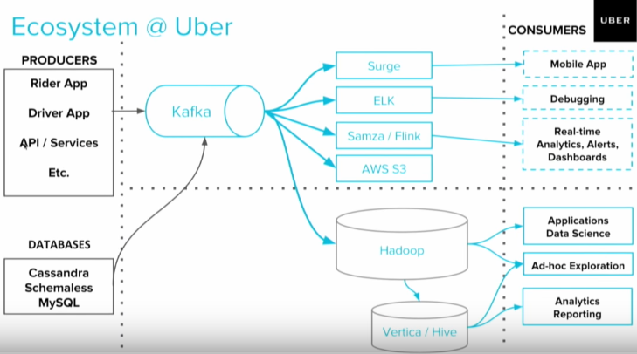

Slide 59
Pinterest Kafka Use Case
Uses Apache Kafka and the Kafka Streams API at large scale
Pinterest is being visited monthly by 200M+ users.
There are over 100B+ pins and 2B+ ideas are searched monthly.
Kafka is leveraged for multiple processes.
Every click, repin or photo enlargement results in Kafka messages.
Kafka Streams are used for content indexing, recommendations, spam detection
Kafka powers the real-time, predictive budgeting system of their advertising infrastructure for real-time ads budgets calculations.

Slide 60
Kafka More Use Case Examples
The New York Times: uses Apache Kafka and the Kafka Streams API to store and distribute, in real-time, published content to the various applications and systems that make it available to the readers.
Adidas: uses Kafka as the core of Fast Data Streaming Platform, integrating source systems and enabling teams to implement real-time event processing for monitoring, analytics and reporting solutions.
Box: Kafka is used for the production analytics pipeline & real time monitoring infrastructure.

Slide 61
Kafka More Use Case Examples
Coursera: Kafka powers education at scale, serving as the data pipeline for realtime learning analytics/dashboards.
CloudFlare: uses Kafka for log processing and analytics pipeline, collecting hundreds of billions of events/day data from a thousands of servers.
HackerRank: uses Kafka as events as a service platform to publish all the internal activity on thier infrastructure into Kafka, and a wide range of internal services subscribe to it.

Slide 62
Kafka More Use Case Examples
Mozilla: In production system to collect performance and usage data from the end-users browser for projects like Telemetry, Test Pilot, etc
Spotify: Kafka is used at Spotify as part of their log delivery system.
Twitter: As part of their Storm stream processing infrastructure
Trivago: uses Kafka for stream processing in Storm as well as processing of application logs.

